Slide 1


Structures and Strategies For Space State Search
3.0 Introduction
3.1 Graph Theory
3.2 Strategies for Space State Search
3.3 Using Space State to Represent Reasoning with the Predicate Calculus
3.4 Epilogue and References
3.5 Exercises
George F Luger
ARTIFICIAL INTELLIGENCE 6th edition
Structures and Strategies for Complex Problem Solving
Luger: Artificial Intelligence, 6th edition. © Pearson Education Limited, 2009
Notes:
Insert chapter number

Slide 2
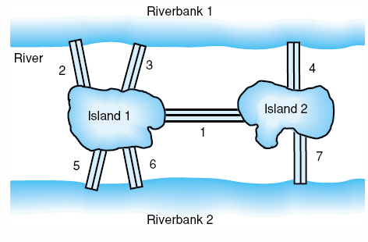
Figure 3.1: The city of Königsberg.
Luger: Artificial Intelligence, 6th edition. © Pearson Education Limited, 2009
Notes:
OWEN: Insert fig 3.1

Slide 3
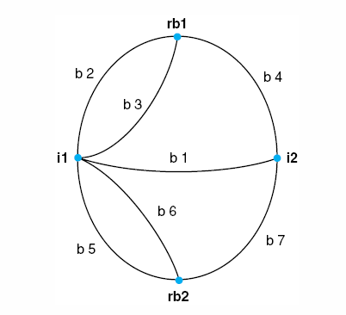
Figure 3.2: Graph of the Königsberg bridge system.
Luger: Artificial Intelligence, 6th edition. © Pearson Education Limited, 2009

Slide 4
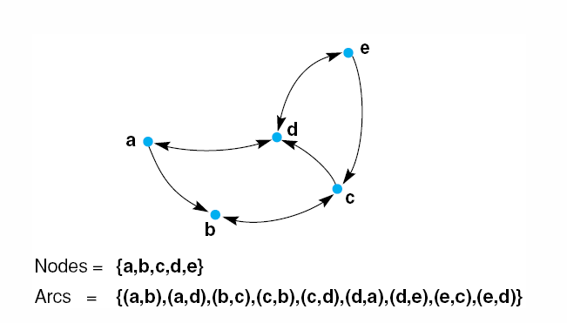
Figure 3.3: A labeled directed graph.
Luger: Artificial Intelligence, 6th edition. © Pearson Education Limited, 2009

Slide 5
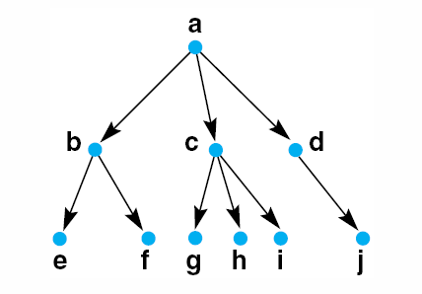
Figure 3.4: A rooted tree, exemplifying family relationships.
Luger: Artificial Intelligence, 6th edition. © Pearson Education Limited, 2009

Slide 6
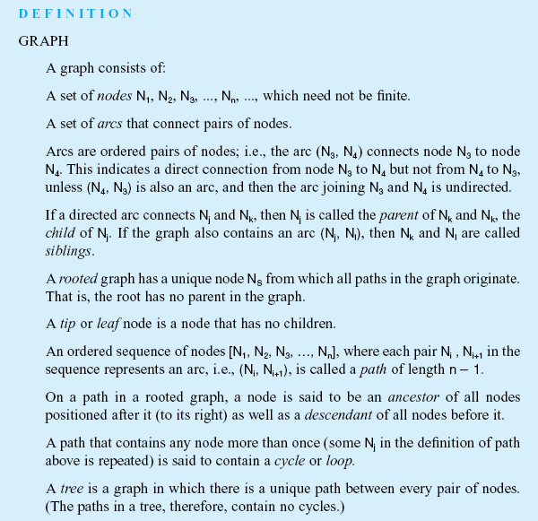

Luger: Artificial Intelligence, 6th edition. © Pearson Education Limited, 2009
Notes:
Insert def box p 84

Slide 7
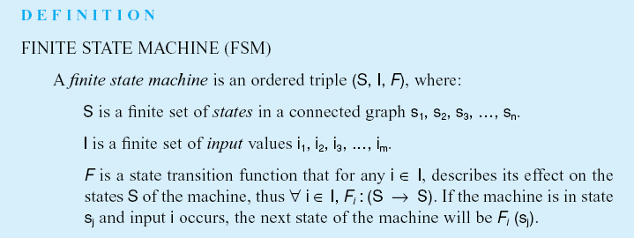
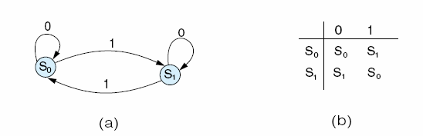
Fig 3.5 (a) The finite state graph for a flip flop and
(b) its transition matrix.
Luger: Artificial Intelligence, 6th edition. © Pearson Education Limited, 2009
Notes:
OWEN: Insert def box p85 plus fig 3.5 a and b

Slide 8
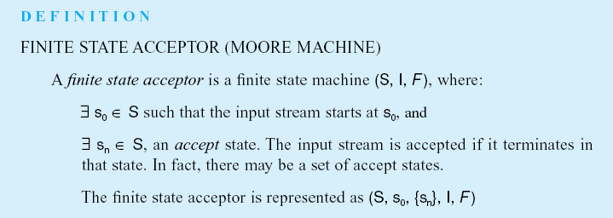
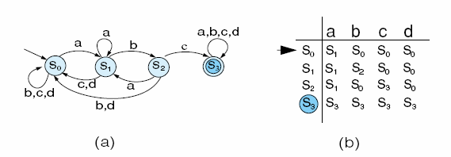
Fig 3.6 (a) The finite state graph and (b) the transition matrix for string recognition example
Luger: Artificial Intelligence, 6th edition. © Pearson Education Limited, 2009
Notes:
OWEN: Insert def box p 86 plus fig 3.6 a and b

Slide 9
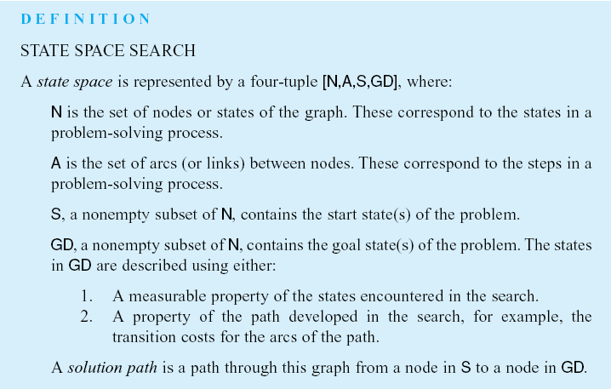
Luger: Artificial Intelligence, 6th edition. © Pearson Education Limited, 2009
Notes:
Insert def box p 88

Slide 10
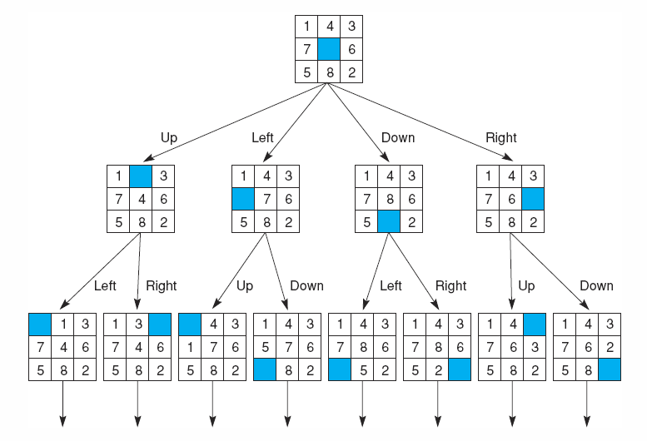
Fig 3.8 State space of the 8-puzzle generated by “move blank” operations
Luger: Artificial Intelligence, 6th edition. © Pearson Education Limited, 2009
Notes:
Insert fig 3.8

Slide 11
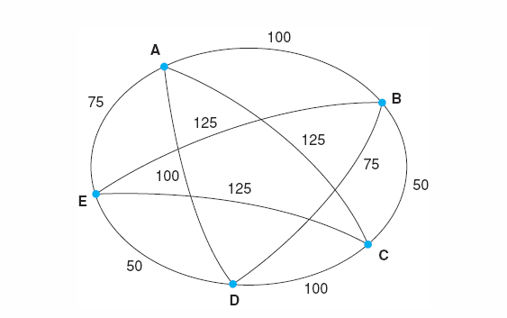
Fig 3.9 An instance of the travelling salesperson problem
Luger: Artificial Intelligence, 6th edition. © Pearson Education Limited, 2009

Slide 12
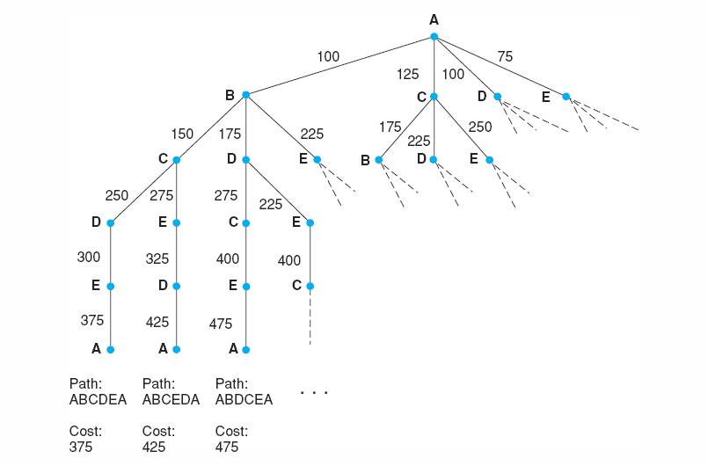
Fig 3.10 Search for the travelling salesperson problem. Each arc is marked with the total weight of all paths from the start node (A) to its endpoint.
Luger: Artificial Intelligence, 6th edition. © Pearson Education Limited, 2009

Slide 13
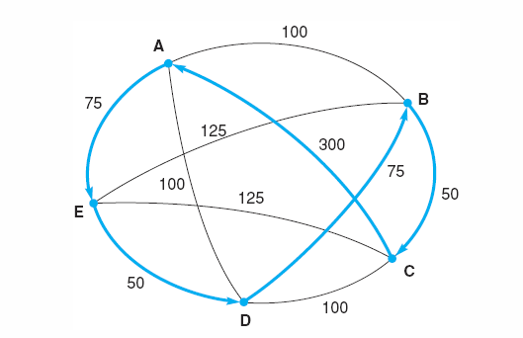
Fig 3.11 An instance of the travelling salesperson problem with the nearest neighbor path in bold. Note this path (A, E, D, B, C, A), at a cost of 550, is not the shortest path. The comparatively high cost of arc (C, A) defeated the heuristic.
Luger: Artificial Intelligence, 6th edition. © Pearson Education Limited, 2009
Notes:
Insert fig 3.11

Slide 14
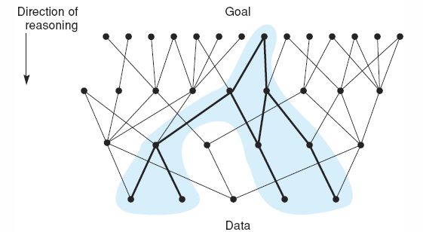
Fig 3.12 State space in which goal-directed search effectively prunes extraneous search paths.
Luger: Artificial Intelligence, 6th edition. © Pearson Education Limited, 2009

Slide 15
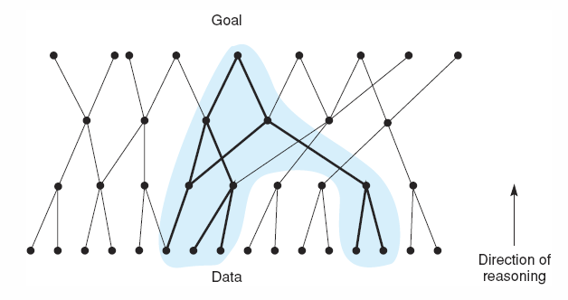
Fig 3.13 State space in which data-directed search prunes irrelevant data and their consequents and determines one of a number of possible goals.
Luger: Artificial Intelligence, 6th edition. © Pearson Education Limited, 2009
Notes:
Insert fig 3.13

Slide 16
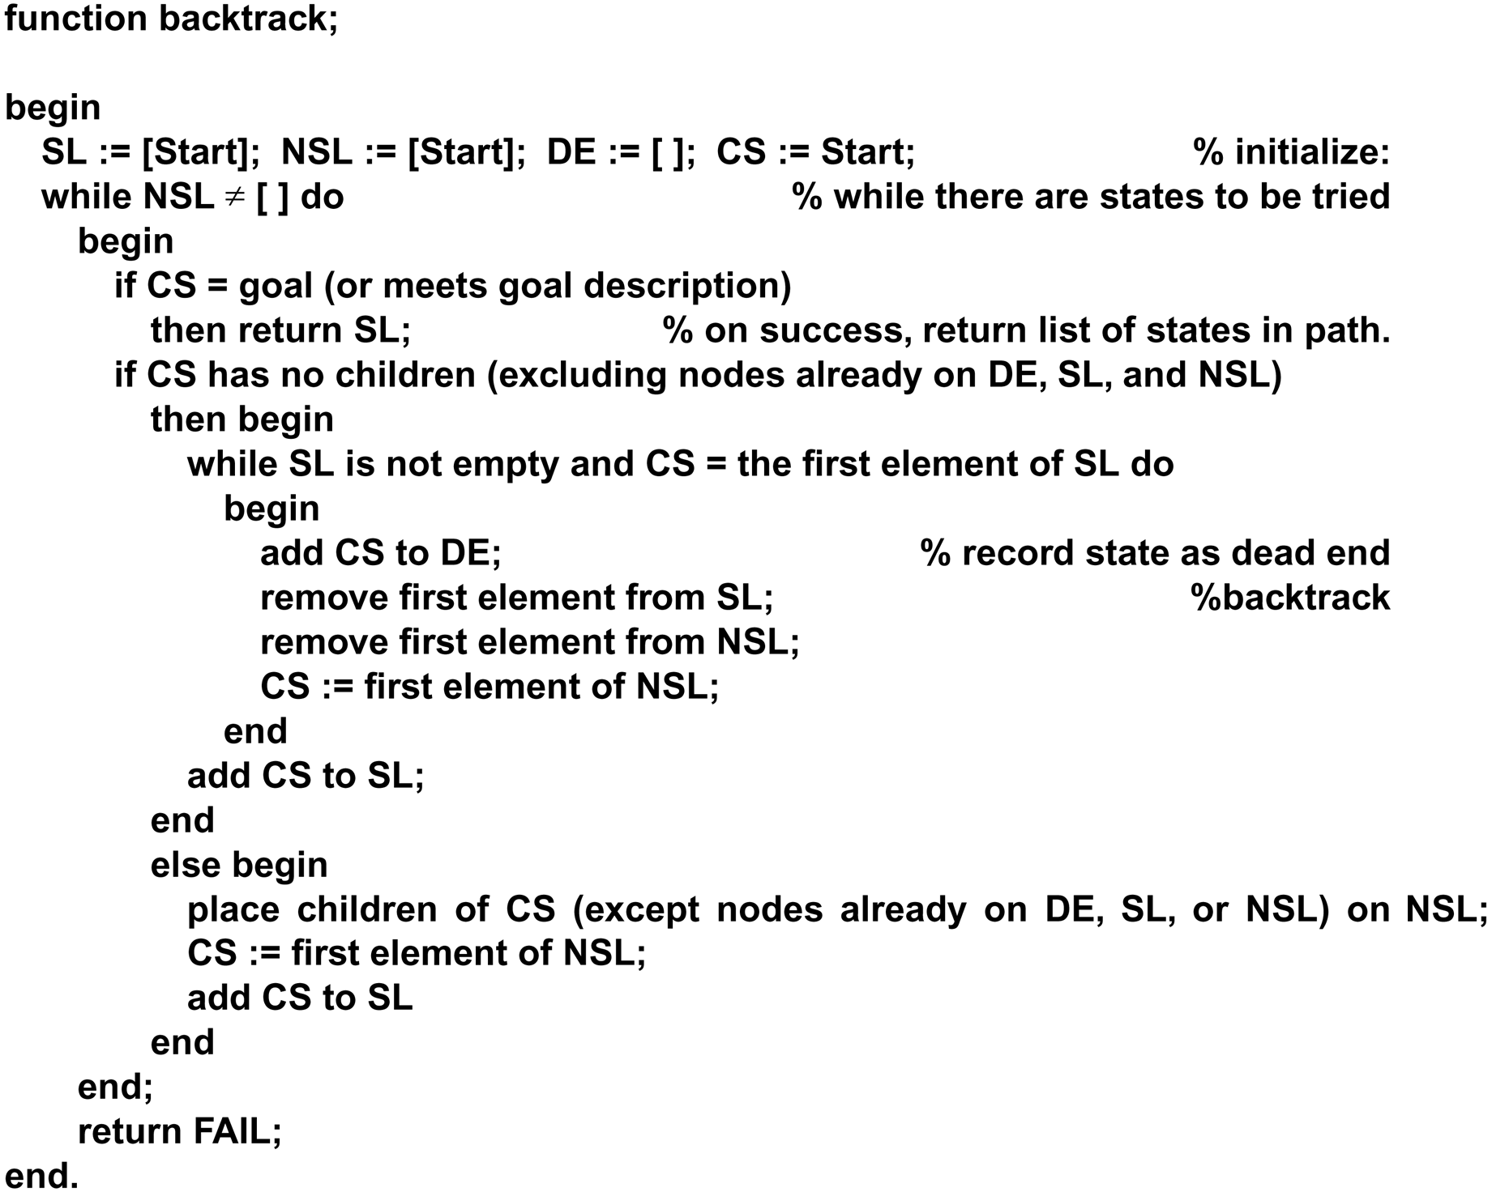
Function backtrack algorithm
Luger: Artificial Intelligence, 6th edition. © Pearson Education Limited, 2009

Slide 17
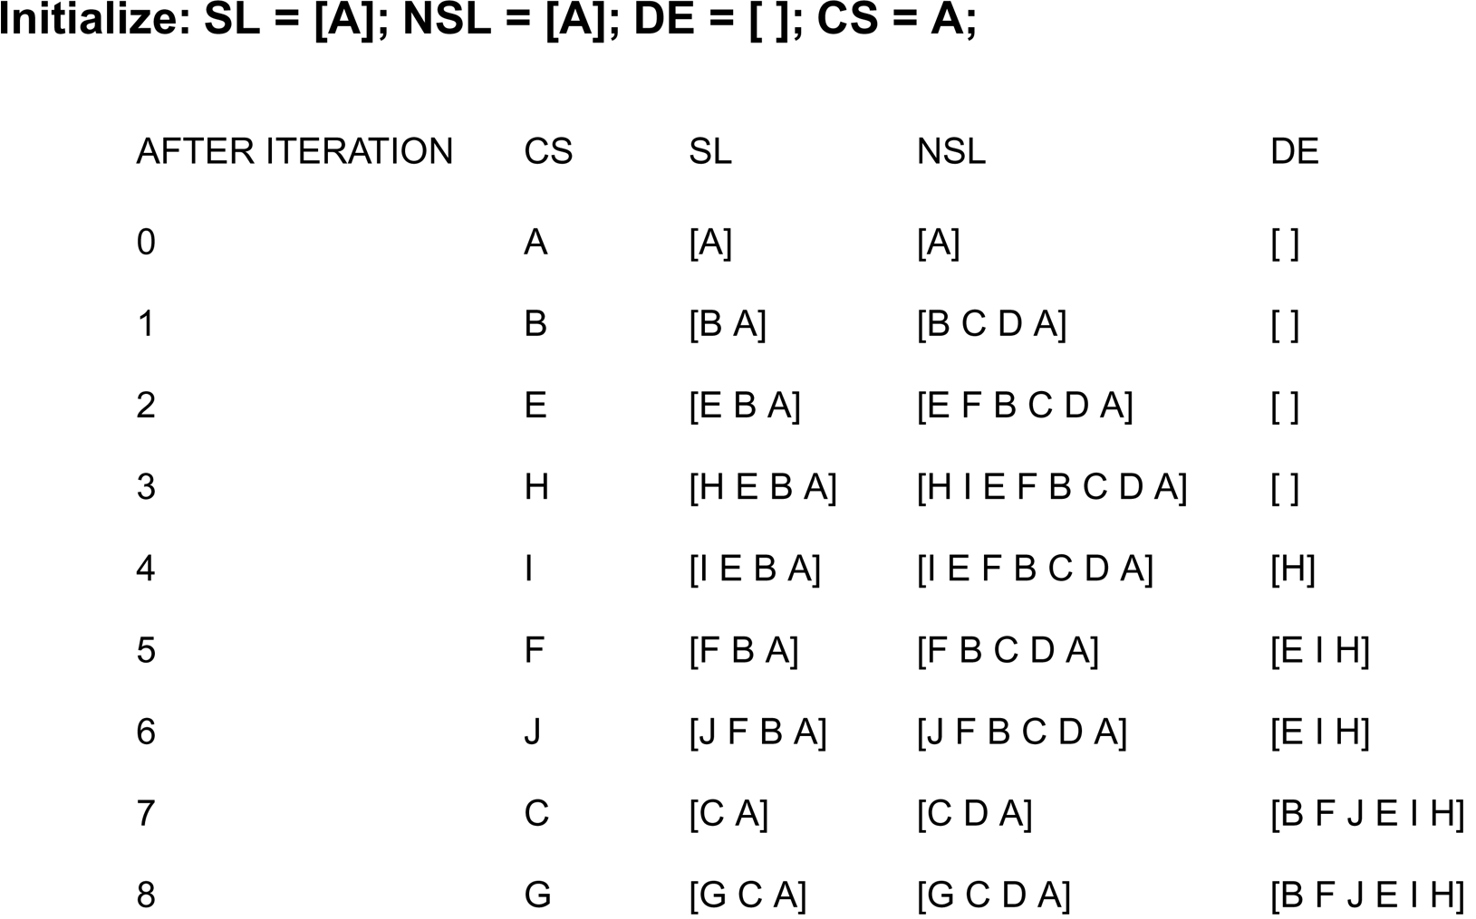
A trace of backtrack on the graph of figure 3.12
Luger: Artificial Intelligence, 6th edition. © Pearson Education Limited, 2009

Slide 18
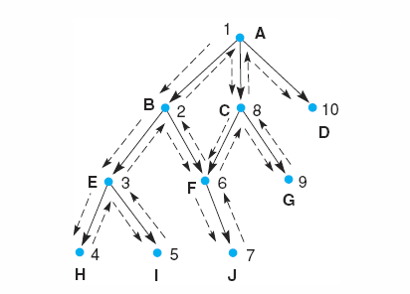
Fig 3.14 Backtracking search of a hypothetical state space space.
Luger: Artificial Intelligence, 6th edition. © Pearson Education Limited, 2009

Slide 19
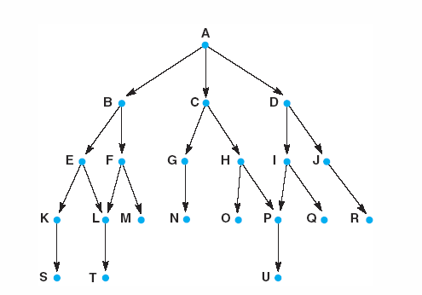
Fig 3.15 Graph for breadth - and depth - first search examples.
Luger: Artificial Intelligence, 6th edition. © Pearson Education Limited, 2009
Notes:
Insert fig 3.15

Slide 20
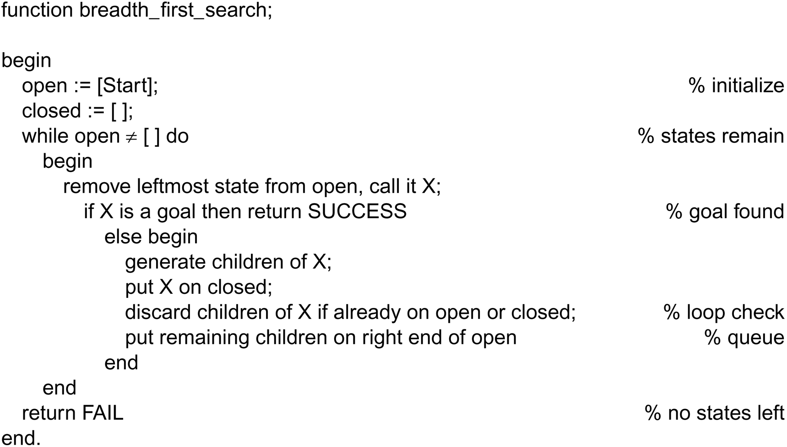
Function breadth_first search algorithm
Luger: Artificial Intelligence, 6th edition. © Pearson Education Limited, 2009

Slide 21
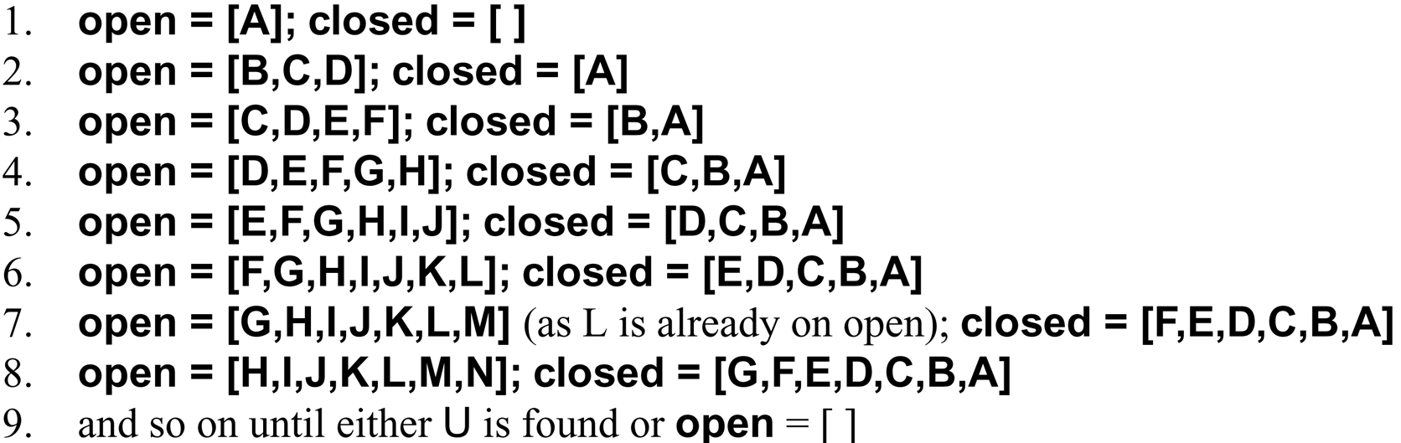
A trace of breadth_first_search on the graph of Figure 3.13
Luger: Artificial Intelligence, 6th edition. © Pearson Education Limited, 2009

Slide 22
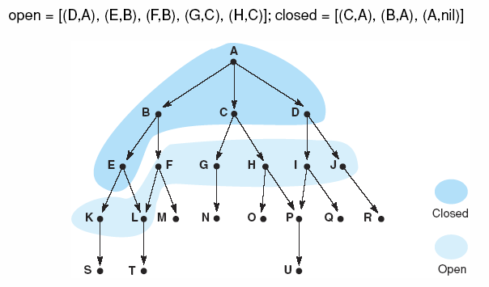
Fig 3.16 Graph of Fig 3.15 at iteration 6 of breadth-first search. States on open and closed are highlighted.
Luger: Artificial Intelligence, 6th edition. © Pearson Education Limited, 2009

Slide 23
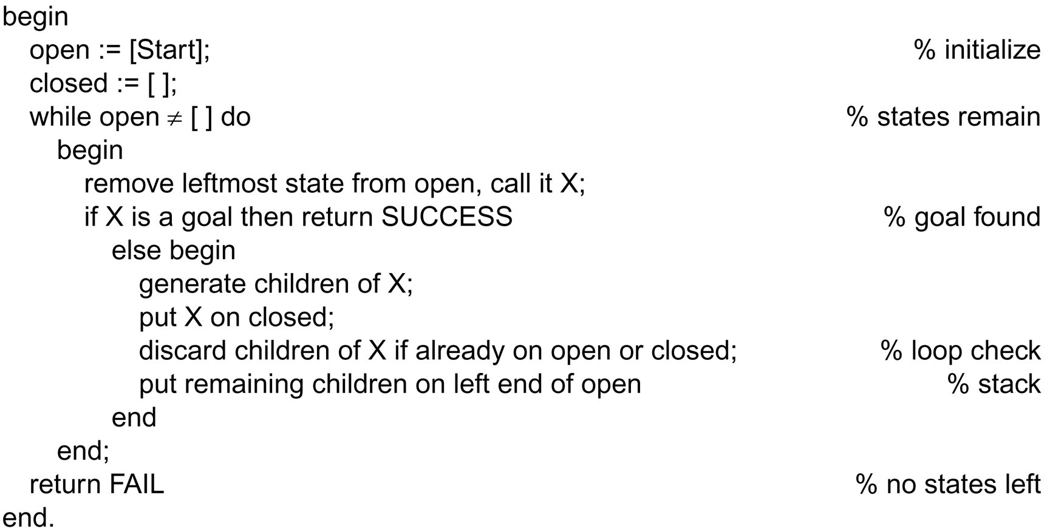
Function depth_first_search algorithm
Luger: Artificial Intelligence, 6th edition. © Pearson Education Limited, 2009

Slide 24
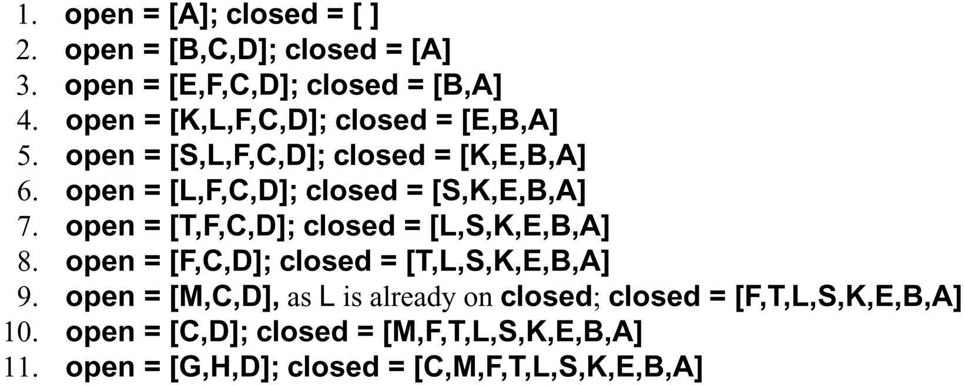
A trace of depth_first_search on the graph of Figure 3.13
Luger: Artificial Intelligence, 6th edition. © Pearson Education Limited, 2009

Slide 25
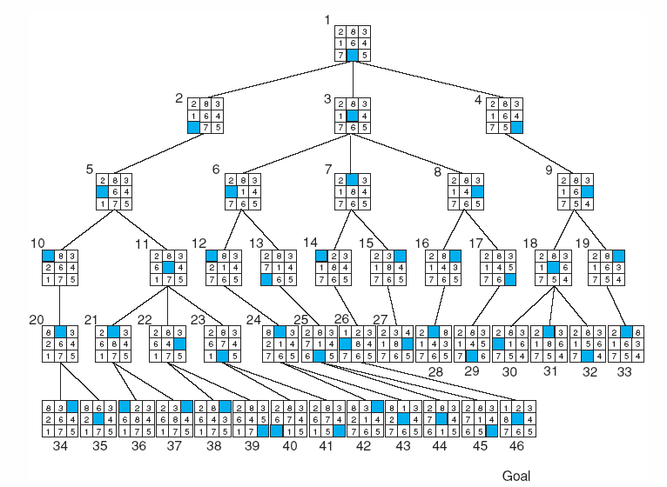
Fig 3.17 Breadth-first search of the 8-puzzle, showing order in which states were removed from open.
Luger: Artificial Intelligence, 6th edition. © Pearson Education Limited, 2009

Slide 26
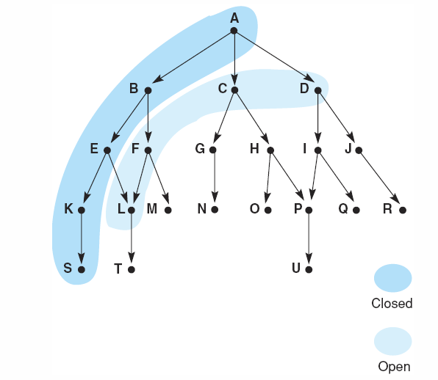
Fig 3.18 Graph of fig 3.15 at iteration 6 of depth-first search. States on open and closed are highlighted.
Luger: Artificial Intelligence, 6th edition. © Pearson Education Limited, 2009

Slide 27
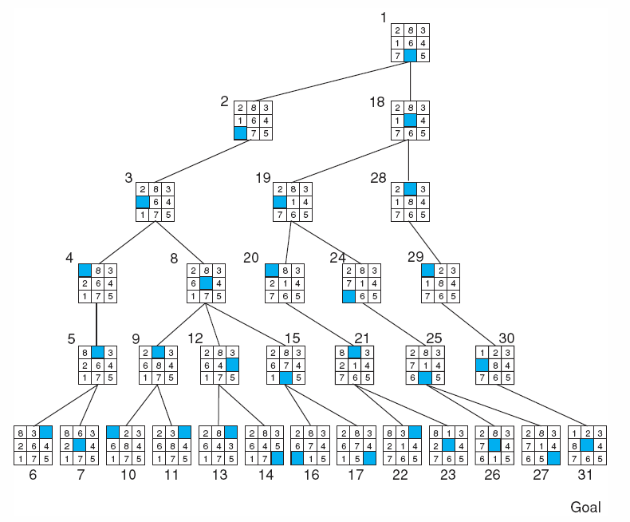
Fig 3.19 Depth-first search of the 8-puzzle with a depth bound of 5.
Luger: Artificial Intelligence, 6th edition. © Pearson Education Limited, 2009

Slide 28
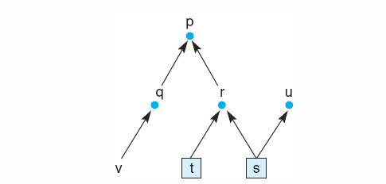
Fig 3.20 State space graph of a set of implications in the propositional calculus.
Luger: Artificial Intelligence, 6th edition. © Pearson Education Limited, 2009

Slide 29
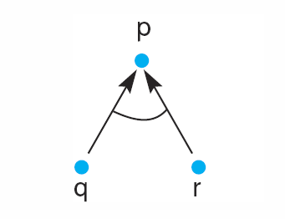
Fig 3.21 And/or graph of the expression q Λ r → p.
Luger: Artificial Intelligence, 6th edition. © Pearson Education Limited, 2009

Slide 30
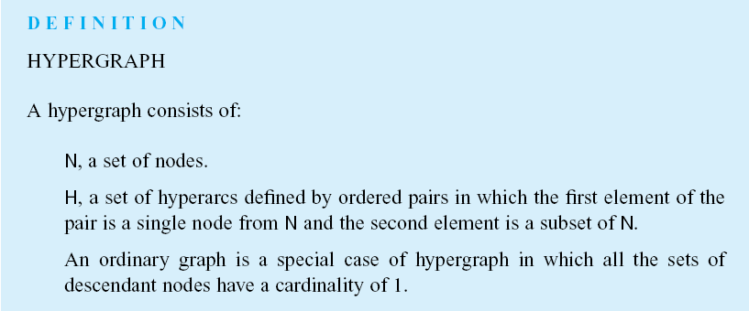
Luger: Artificial Intelligence, 6th edition. © Pearson Education Limited, 2009

Slide 31
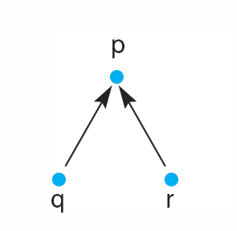
Fig 3.22 And/or graph of the expression q v r → p
Luger: Artificial Intelligence, 6th edition. © Pearson Education Limited, 2009
Notes:
Insert fig 3.22

Slide 32
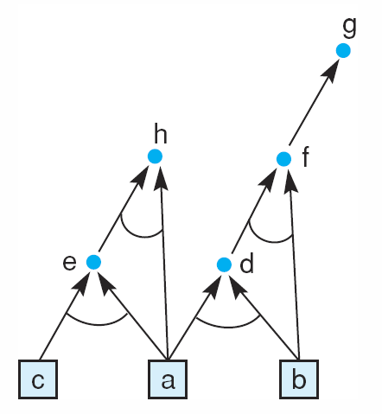
Fig 3.23 And/or graph of a set of propositional calculus expressions.
Luger: Artificial Intelligence, 6th edition. © Pearson Education Limited, 2009

Slide 33
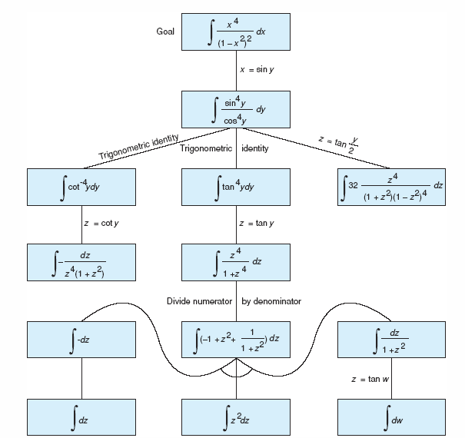
Fig 3.24 And/or graph of part of the state space for integrating a function, from Nilsson (1971).
Luger: Artificial Intelligence, 6th edition. © Pearson Education Limited, 2009

Slide 34
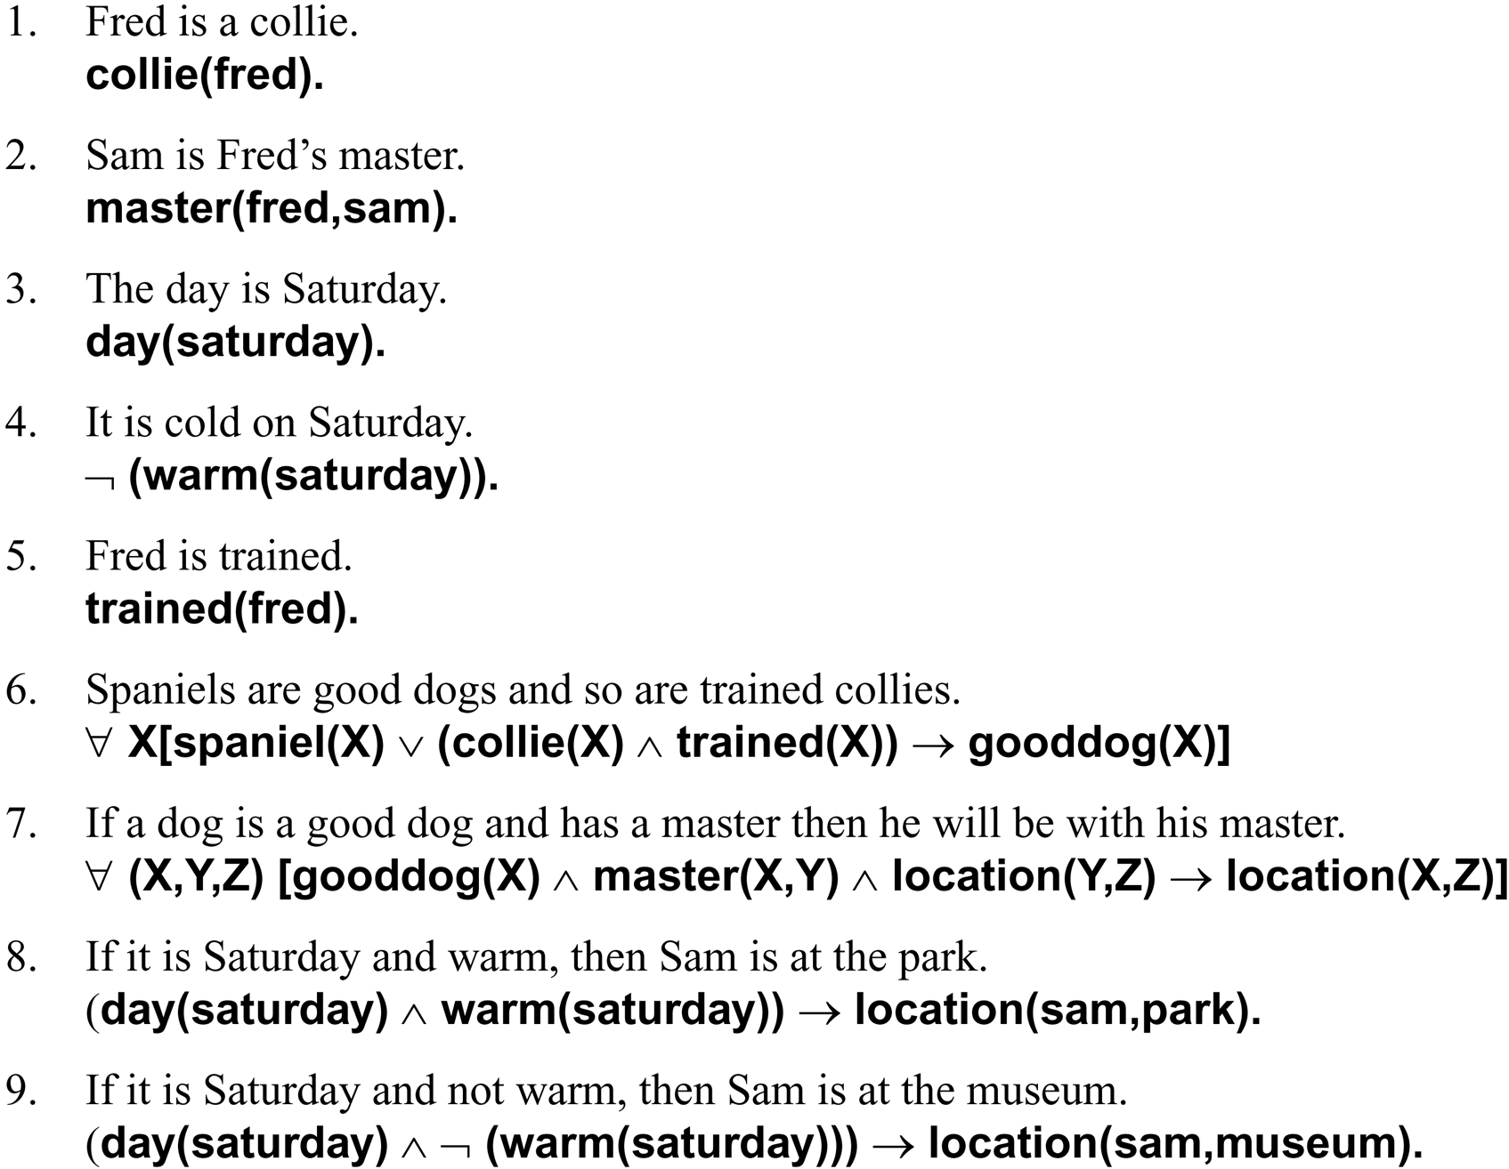
The facts and rules of this example are given as English sentences followed by their predicate calculus equivalents:
Luger: Artificial Intelligence, 6th edition. © Pearson Education Limited, 2009

Slide 35
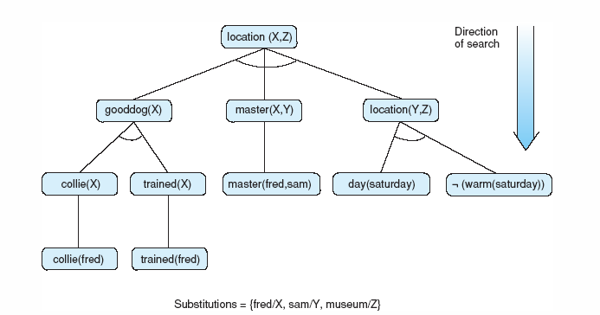
Fig 3.25 The solution subgraph showing that Fred is at the museum.
Luger: Artificial Intelligence, 6th edition. © Pearson Education Limited, 2009

Slide 36
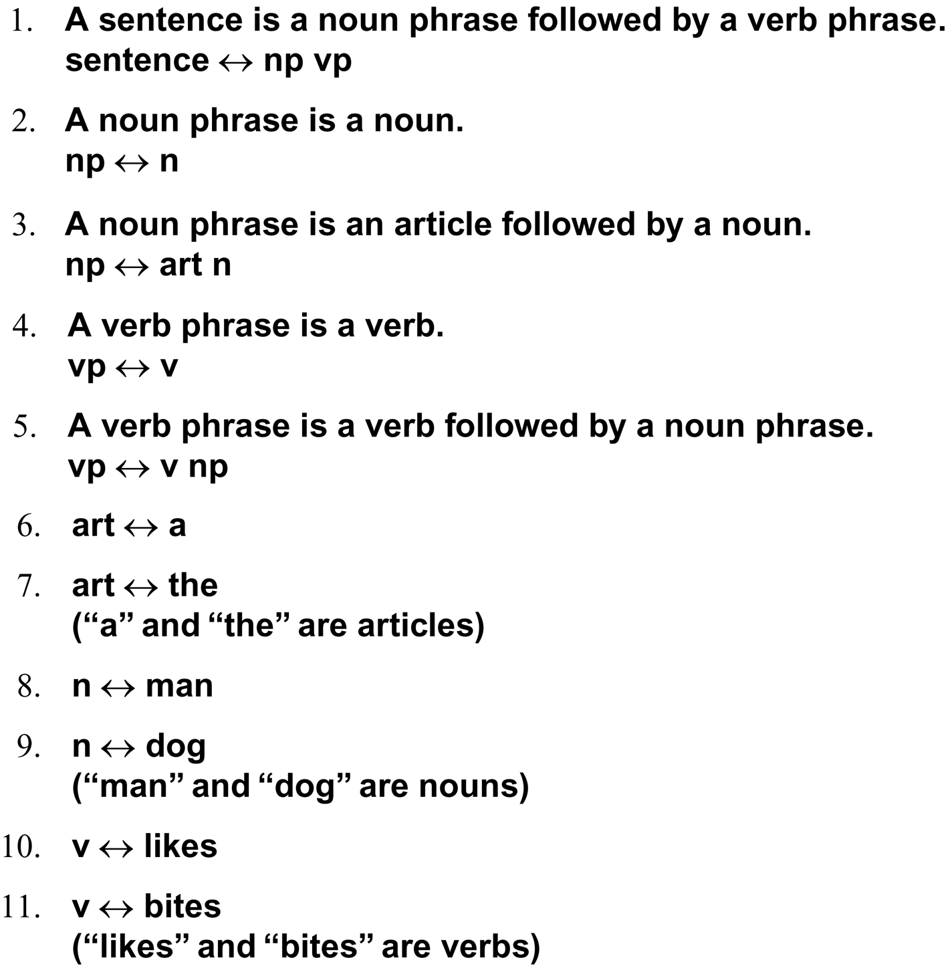
Five rules for a simple subset of English grammar are:
Luger: Artificial Intelligence, 6th edition. © Pearson Education Limited, 2009

Slide 37
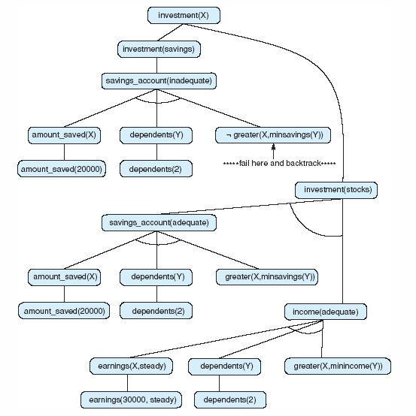
Fig 3.26 And/or graph searched by the financial advisor.
Luger: Artificial Intelligence, 6th edition. © Pearson Education Limited, 2009

Slide 38
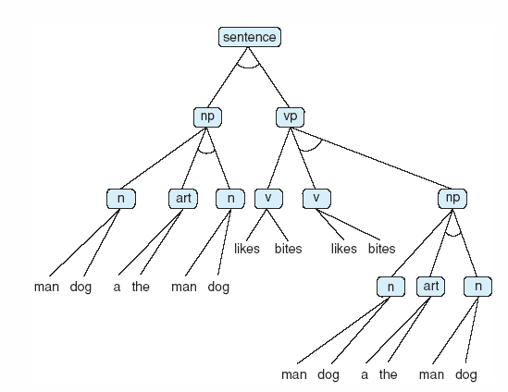
Fig 3.27 And/or graph for the grammar of Example 3.3.6. Some of the nodes (np, art, etc) have been written more than once to simplify drawing the graph.
Luger: Artificial Intelligence, 6th edition. © Pearson Education Limited, 2009

Slide 39
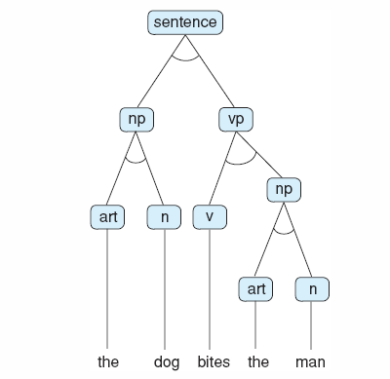
Fig 3.28 Parse tree for the sentence “The dog bites the man.” Note this is a subtree of the graph of fig 3.27.
Luger: Artificial Intelligence, 6th edition. © Pearson Education Limited, 2009

Slide 40
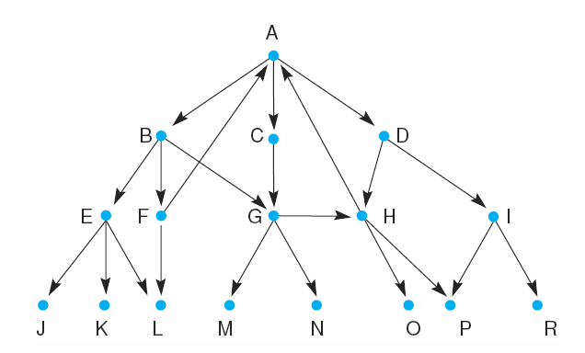
Fig 3.29 A graph to be searched.
Luger: Artificial Intelligence, 6th edition. © Pearson Education Limited, 2009

